Slide 1

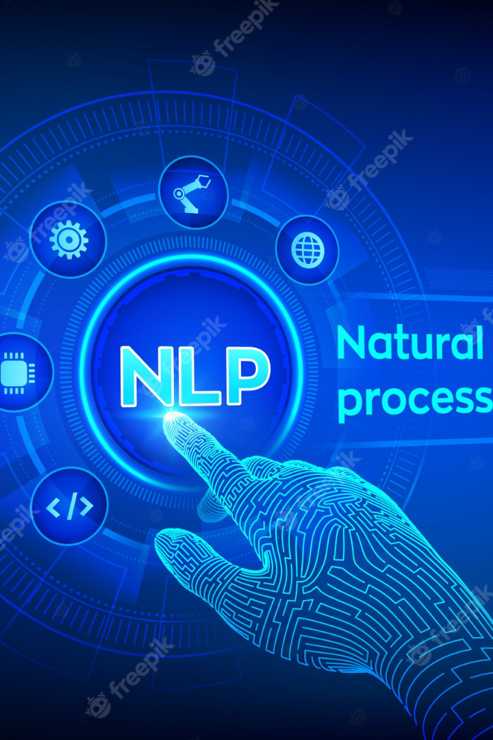
Text Processing For NLP Doc2Vec
Welcome to the world of text processing with Doc2Vec! In this presentation, we will explore the mechanics and benefits of this powerful technique, as well as its real-world applications.

Slide 2
Understanding Doc2Vec
1
2
3
What is Doc2Vec?
How Does it Work?
Why is it Important?
A novel technique for computing vector representations of entire documents.
Doc2Vec learns vector representations of documents by predicting words within the document.
Doc2Vec enables us to analyze documents as continuous vectors in multi-dimensional space, opening up new possibilities for text analysis.

Slide 3

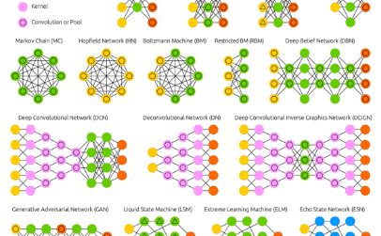
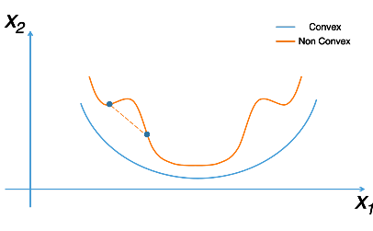
Delving into the Mechanics of Doc2Vec
The Role of Context
Neural Network Architecture
Gradient Descent Optimization
Contextual information is crucial for learning document representations, as it enables the model to capture the meaning of words within the context of the document.
The Doc2Vec model consists of two neural networks: the Paragraph Vector (PV) network, which learns document vectors, and the Word Vector (WV) network, which learns word vectors.
The Doc2Vec model is trained using stochastic gradient descent, a powerful optimization algorithm that enables the model to learn from large amounts of data.

Slide 4
Unveiling the Benefits of Doc2Vec in NLP
Improved Text Classification
Efficient Document Retrieval
Robust Information Extraction
Doc2Vec can be used to transform documents into continuous vectors that can be used as input to machine learning models for text classification tasks.
Doc2Vec enables us to search for documents based on semantic similarity, rather than just keyword-based matching, leading to more accurate and efficient document retrieval.
Doc2Vec can be used to extract meaningful information from unstructured text data, enabling more accurate and efficient information extraction for natural language processing tasks.

Slide 5
Amplifying NLP with Doc2Vec: Real-world Applications
1
Question Answering Systems
Doc2Vec can be used to create question answering systems that can automatically answer questions based on the semantic content of the document.
Clinical Natural Language Processing
2
Doc2Vec can be used to analyze and extract information from clinical reports, enabling more efficient and accurate analysis of patient medical data.
3
Sentiment Analysis
Doc2Vec can be used to analyze the sentiment of large volumes of text data, enabling more accurate and efficient sentiment analysis for market research and social media monitoring.

Slide 6
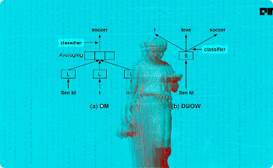

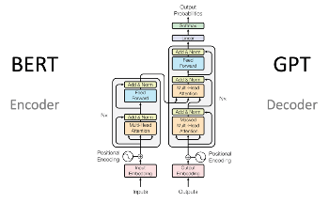
Harnessing the Power of Context: Contextualized Document Representations
What are Contextualized Document Representations?
ELMO: A Powerful Contextualized Encoder
BERT: A Transformer-based Encoder
BERT is a powerful transformer-based encoder that can generate contextualized embeddings for words and sentences, enabling highly accurate natural language processing tasks such as text classification and question answering.
ELMO is a state-of-the-art contextual encoder that can generate contextualized embeddings for words and sentences, enabling more accurate and efficient natural language processing tasks.
Contextualized document representations are document vectors that capture not only the meaning of the words in the document, but also their contextual relationships with other words in the document.

Slide 7

Unraveling the Challenges of Implementing Doc2Vec
1
Data Preprocessing Challenges
2
Hyperparameter Tuning
Preparing large volumes of text data for Doc2Vec training can be challenging, as it requires extensive cleaning, normalization, and tokenization.
Finding the optimal combination of hyperparameters for the Doc2Vec model can be challenging, as it requires extensive experimentation and tuning.
3
Model Complexity
The Doc2Vec model can be computationally intensive to train, especially when dealing with very large volumes of text data.

Slide 8
Balancing Precision and Efficiency: Training Complex Models
Challenges
Solutions
Training complex Doc2Vec models can be challenging, as it requires finding the right balance between precision and efficiency.
There are several techniques that can be used to improve the efficiency and precision of Doc2Vec models, such as hierarchical softmax, negative sampling, and subsampling of frequent words.

Slide 9
Data Size and Quality: Impact on Doc2Vec's Performance
Data Size
Data Quality
Impact
Larger volumes of text data can lead to more accurate and robust Doc2Vec models, while poor quality data can result in poorer performance.
High-quality data can lead to better-performing models, while low-quality data can negatively impact performance.
Solutions
To improve model performance, it's important to use large volumes of high-quality text data, and to preprocess the data carefully before training.
Using high-quality data and carefully cleaning and preprocessing the data can help improve model performance.

Slide 10

Charting the Course Ahead: Future Directions for Doc2Vec
1
Continued Innovation
2
Application to New Domains
The field of natural language processing is rapidly evolving, and there is continued scope for innovation in the development of Doc2Vec and other text processing techniques.
Doc2Vec has the potential to be applied to a wide range of new domains, including social media, e-commerce, and public health.
3
Integration with Other NLP Techniques
Doc2Vec can be integrated with other NLP techniques, such as named entity recognition and sentiment analysis, to improve overall model performance.

Slide 11
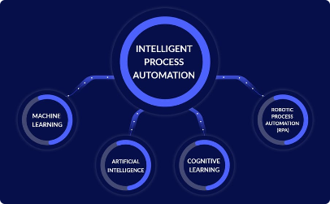


Empowering NLP: Maximizing the Potential of Doc2Vec
Automating NLP Tasks
Visualizing Text Data
Building Intelligent Chatbots
Doc2Vec enables us to automate many natural language processing tasks, including text classification, sentiment analysis, and document retrieval.
Doc2Vec can be used to create visualizations of text data, enabling us to better understand the structure and meaning of large volumes of text.
Doc2Vec can be used to build intelligent chatbots that can understand and respond to natural language queries, enabling more efficient and effective communication with customers and users.

Slide 12
Conclusion: Embracing Doc2Vec's Contributions to NLP
Key Takeaways
Call to Action
Doc2Vec is a powerful technique for computing vector representations of entire documents, enabling a wide range of natural language processing tasks.
Let's start leveraging the power of Doc2Vec in our natural language processing workflows and explore its potential to automate, visualize, and communicate text data more effectively.

